Slide 1
Stanford ME469: Mesh Motion: Sliding Mesh and Overset
Stefan P. Domino
Computational Thermal and Fluid Mechanics
Sandia National Laboratories SAND2018-4619 PE

Slide 2
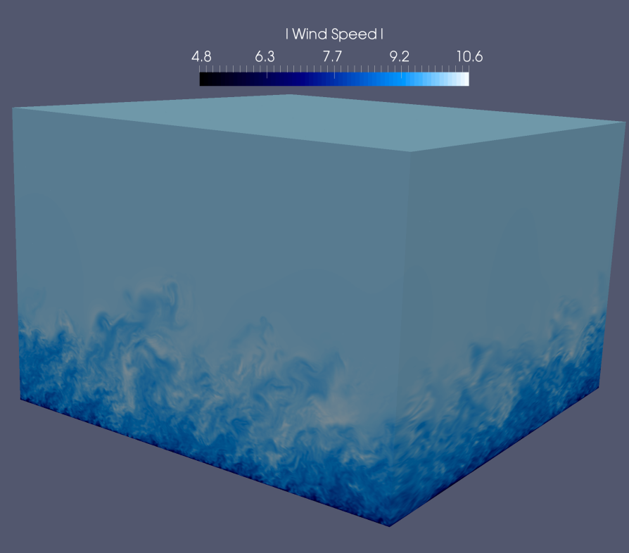
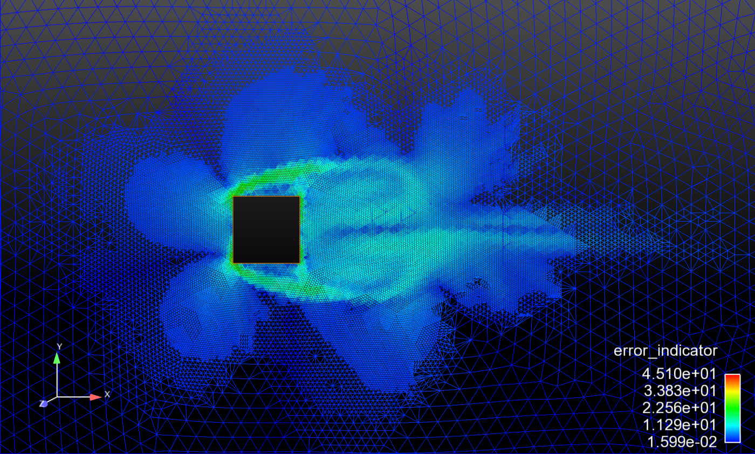
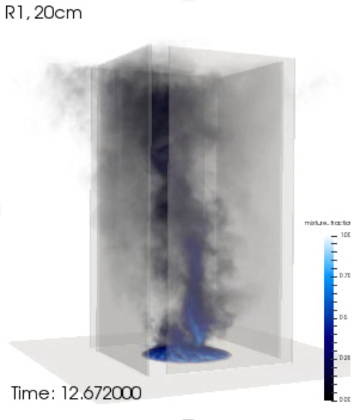
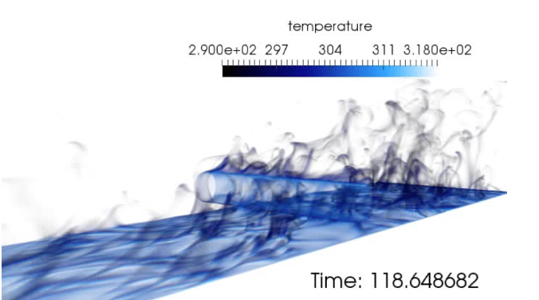
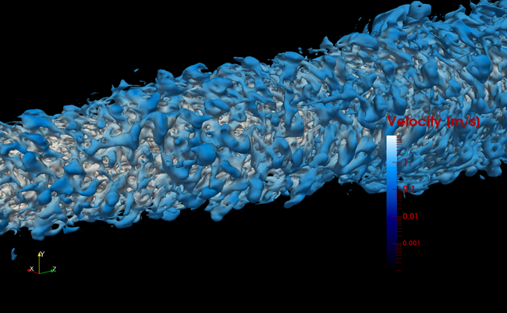
Thus Far, Domain is Stationary

Slide 3
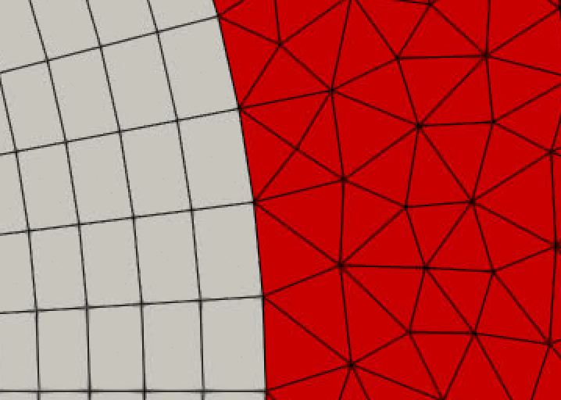
Conformal Meh Review
For a conformal mesh, blocks are connected by a common set of nodes that share the same global identification number

Slide 4
Dual Mesh for this Conformal Example
Control volume is closed

Slide 5
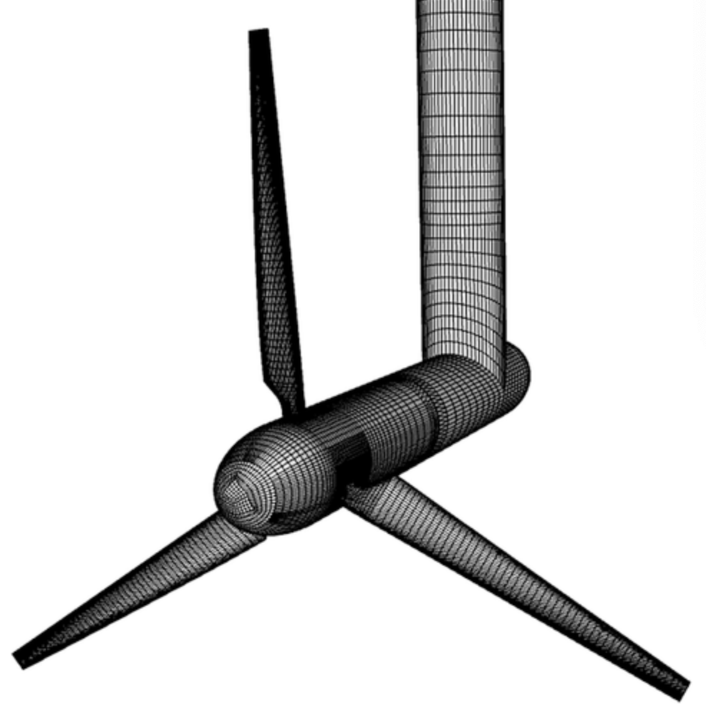
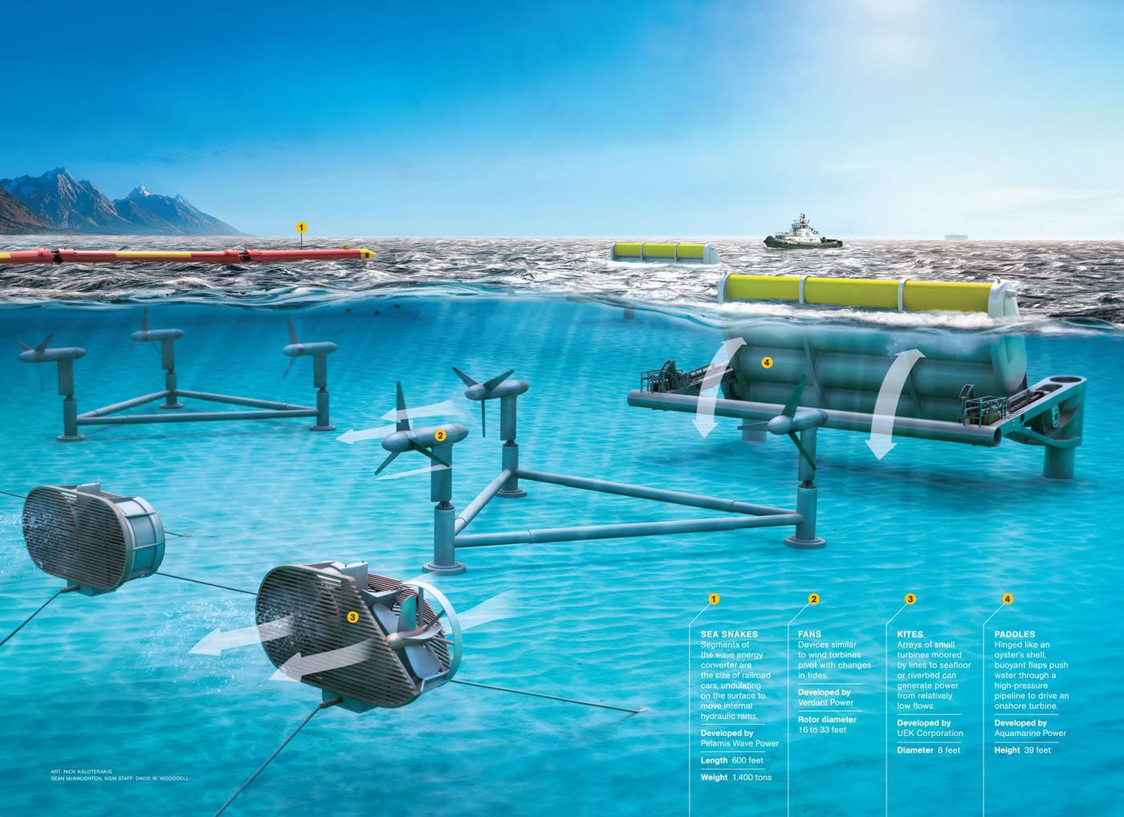
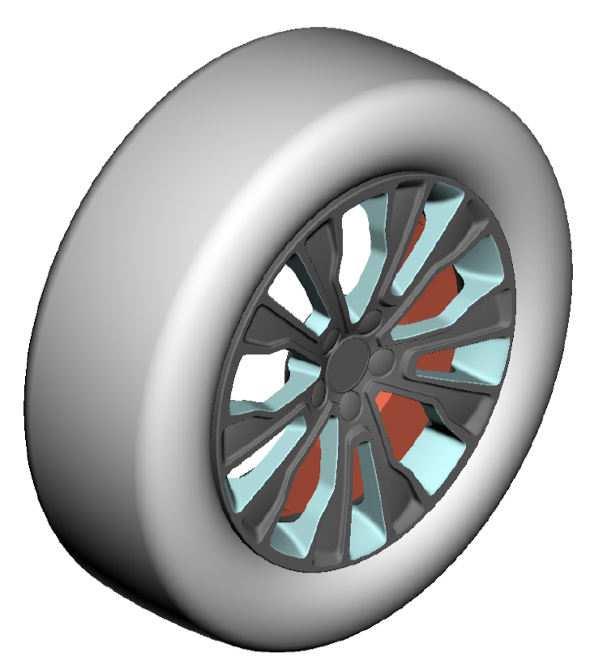
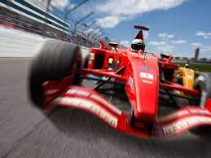
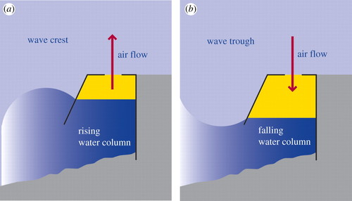
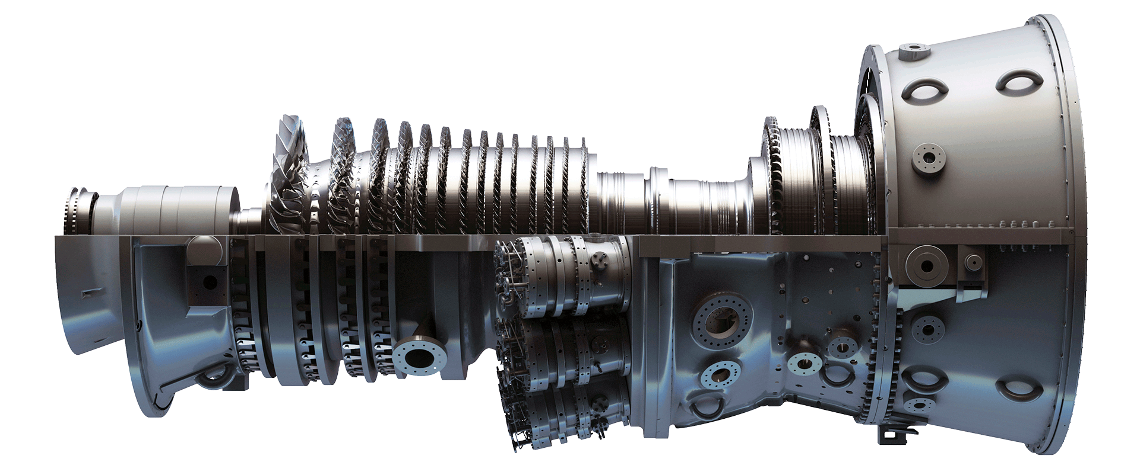
Complex Geometry Use-Cases: Wind, Tidal, Gas Turbines, etc.
Uriegas, “CFD Investigation on Sliding Mesh as a Method to Model Wheel Rotation Implementation and Analysis on Diﬀerent Rims”, 2018
McNaughton et al., “A simple sliding-mesh interface procedure and its application to the CFD simulation of a tidal-stream turbine”, Num. Method. Fluids, 2010
Heath, “A review of oscillating water columns”, Royal Society (2012)
https://www.ge.com/gas-power/products/gas-turbines/7f

Slide 6
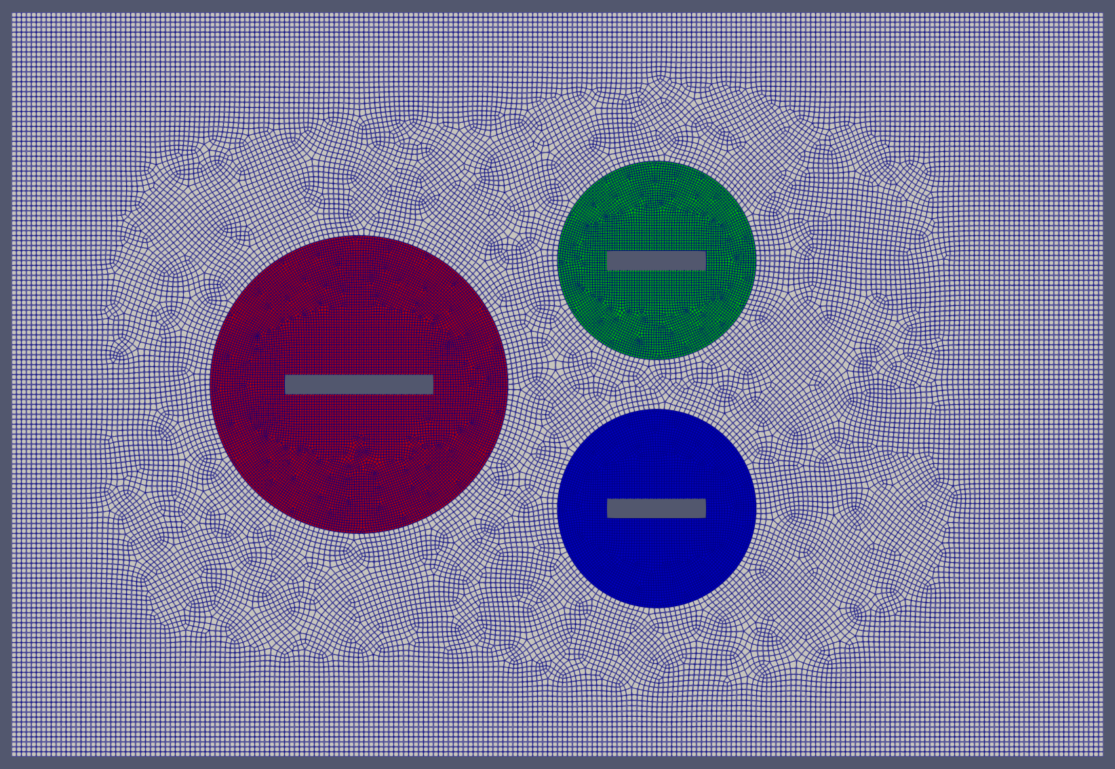
Non-Conformal
Mesh interface holds unique non-matching global IDS
Control-volume not closed by mesh

Slide 7
Non-Conformal: From the Beginning…
Although many applications are moving, this could simply be a procedure to simplify meshing

Slide 8
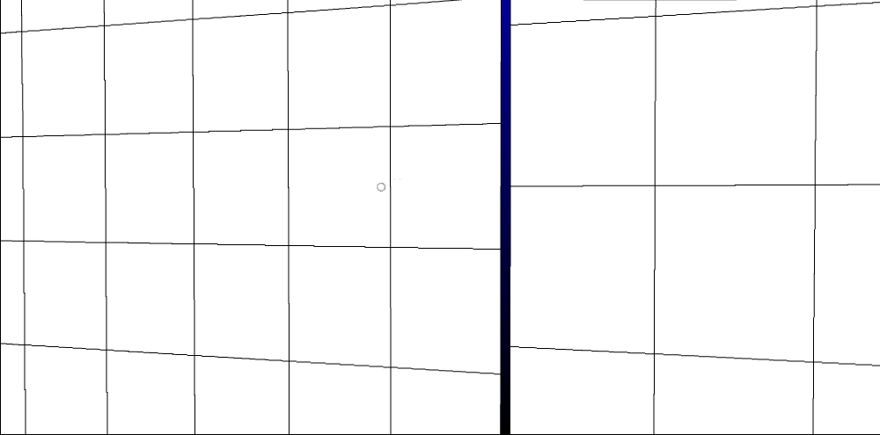
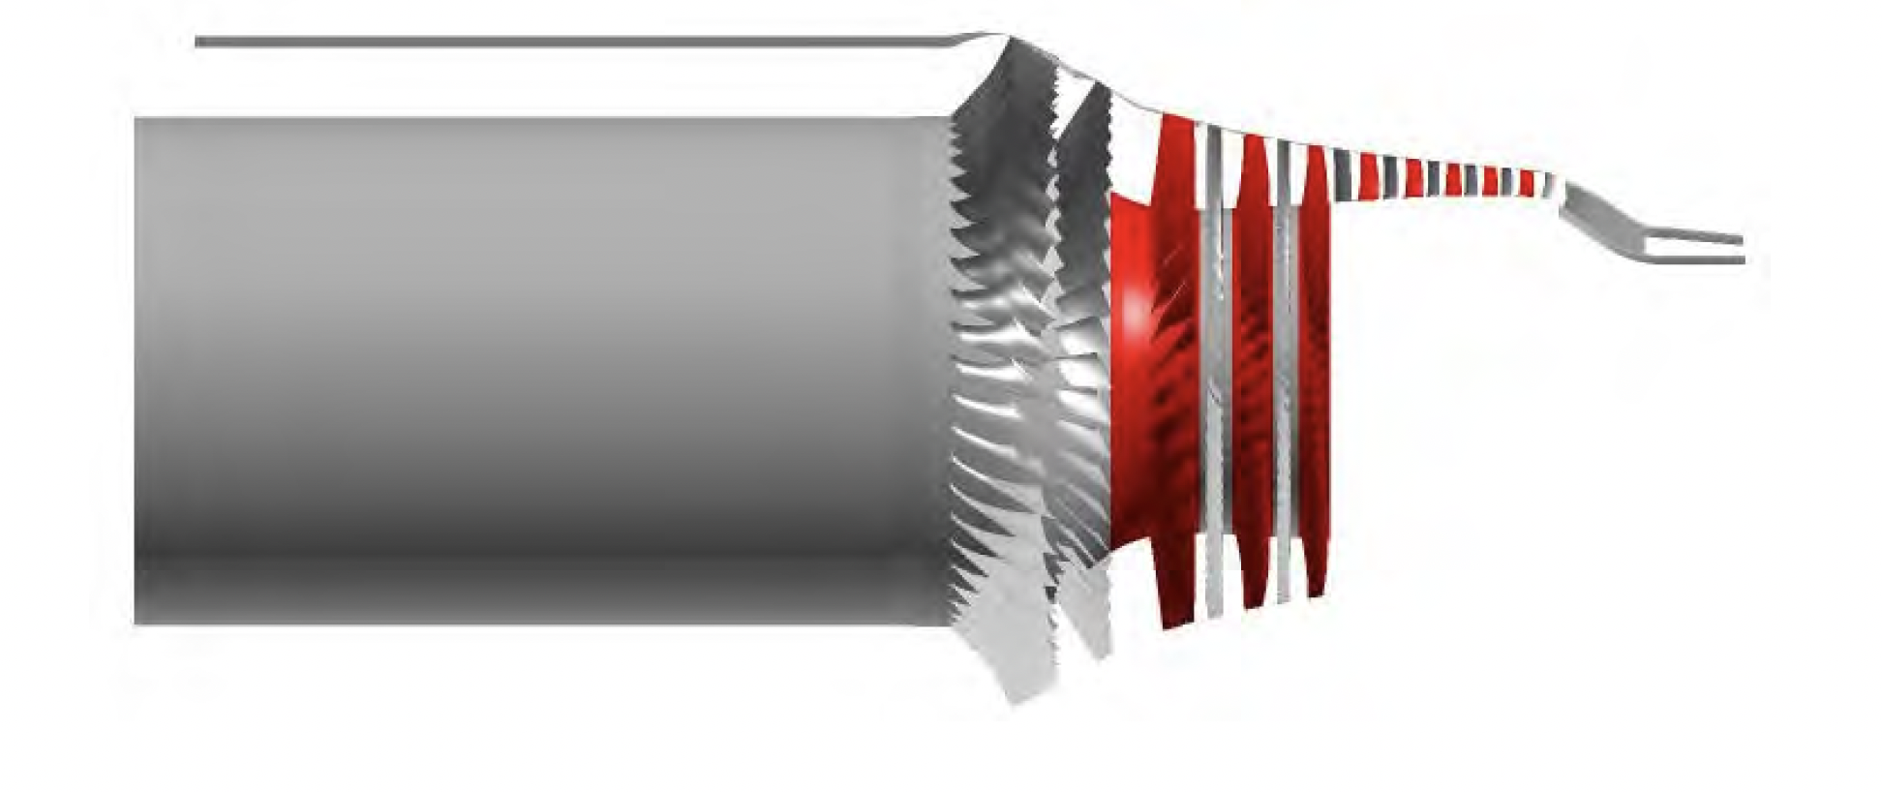
Halo-based Approach for Non-Conformal Interfaces
Has the “flavor” of an overset method; i.e., extrusion of surface mesh to opposing domain with reconstruction of states; Common in cell-centered schemes
Two-pass algorithm: surface_1:block_2 and surface_2:block_1
See Stejil, 2008 and extrusion-based of Blades, 2006; Dodds, 2016
First implemented in low-Mach Nalu for wind-energy applications
Sayma et al. “Modeling three-
dimensional viscous compressible
turbomachinery flows using
unstructured hybrid grids. AIAA
Journal, 38(6):945–954, 2000

Slide 9
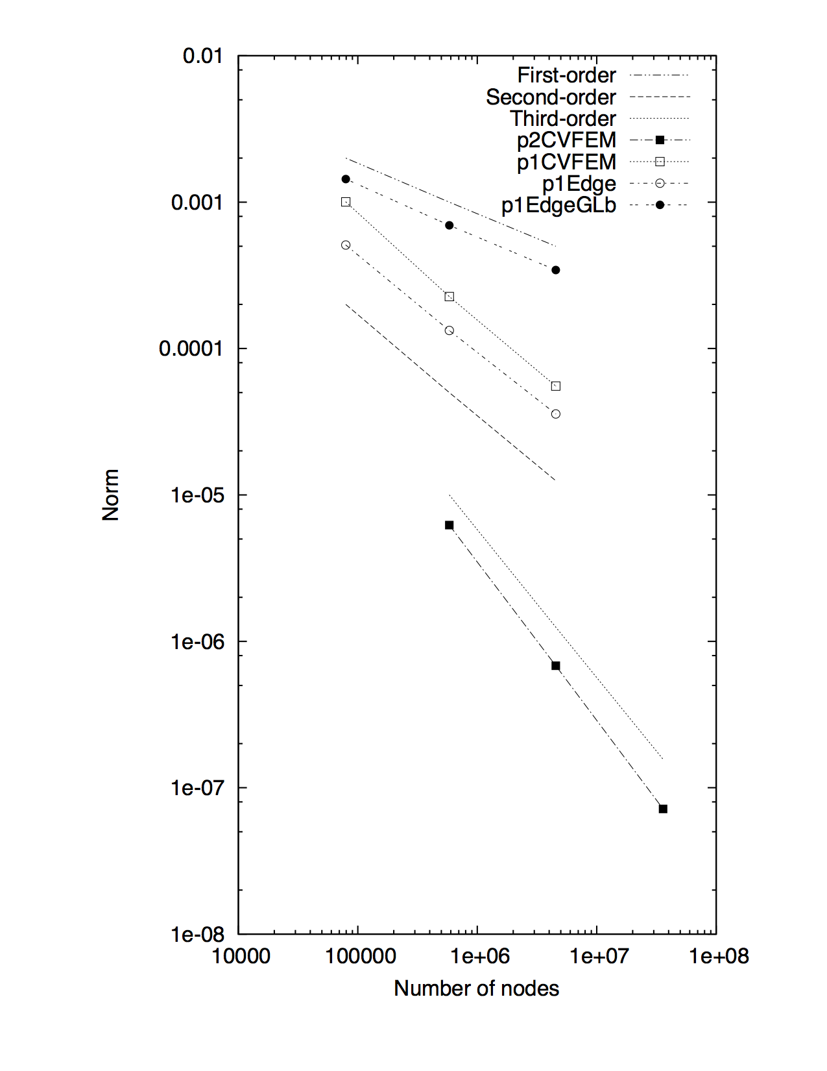
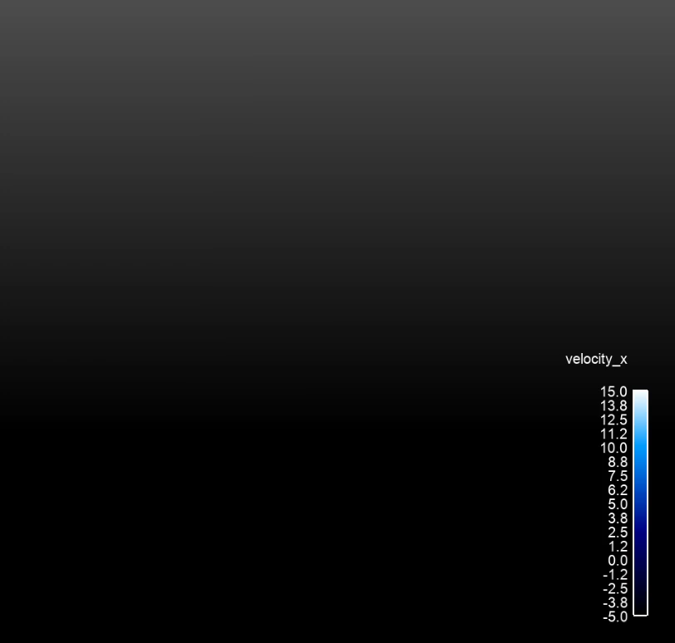
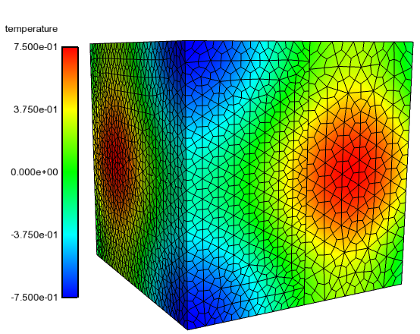
Alternatives? Hybrid Discontinuous Galerkin/CVFEM
Domino, S. P., "Design-order, non-conformal low-Mach fluid algorithms using a hybrid CVFEM/DG approach ", J. Comput. Physics, 2018, https://doi.org/10.1016/j.jcp.2018.01.007
Vestas V27 225 kW from: Domino et al. "An assessment of atypical mesh topologies for low-Mach
large-eddy simulation", Comp. Fluids, 2019, https://doi.org/10.1016/j.compfluid.2018.12.002

Slide 10
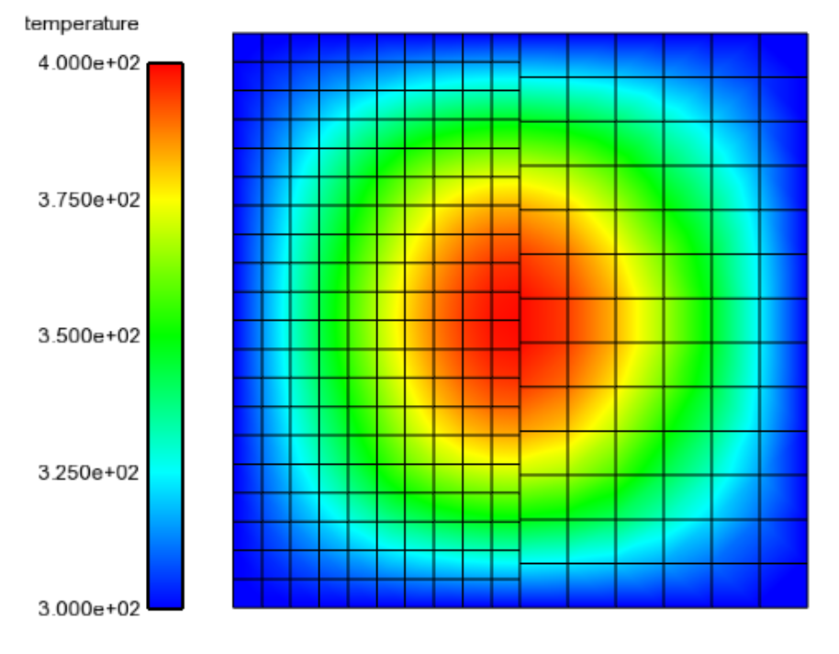
Alternatives? Hybrid Discontinuous Galerkin/CVFEM
Surface-based; accurate for higher-order
Natural extension for vertex-based schemes
No extrusion principles
Pass A:B
Pass B:A
A
B
A
B
Image (left) is shown to have a gap, however, in general, the mesh has a like-representation of the geometry (right)

Slide 11
Hybrid Discontinuous Galerkin/CVFEM: Theory
Interior Penalty Discontinuous Galerkin, Arnold et al., “Unified analysis of the discontinuous Galerkin method for Elliptic problems, SIAM J. Numer. Anal. (2008)

Slide 12
Hybrid Discontinuous Galerkin/CVFEM: Theory
Interior Penalty Discontinuous Galerkin, Arnold et al., “Unified analysis of the discontinuous Galerkin method for Elliptic problems, SIAM J. Numer. Anal. (2008)
Robin-Style
Low-Order Penalty
(constraint-based)

Slide 13
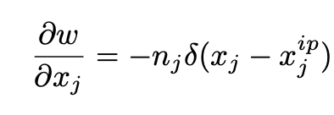
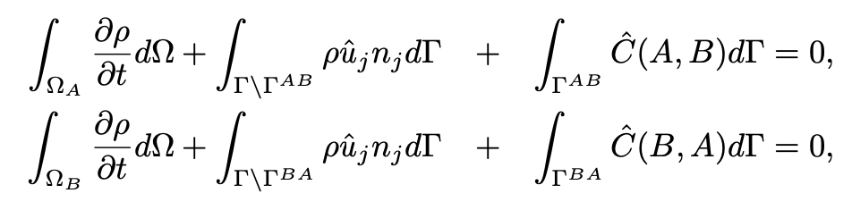
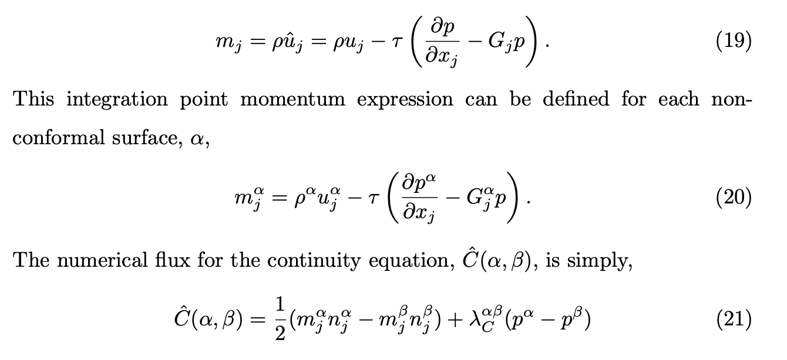
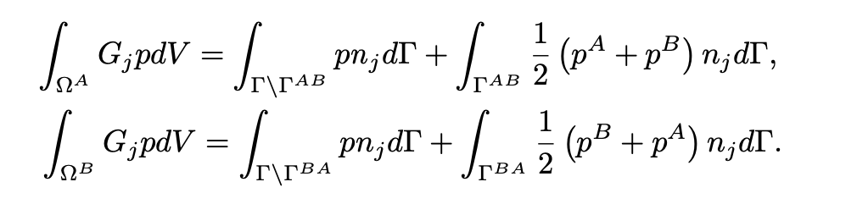
CVFEM and EBVC Fluids-Based (Same Approach)
Continuity

Slide 14
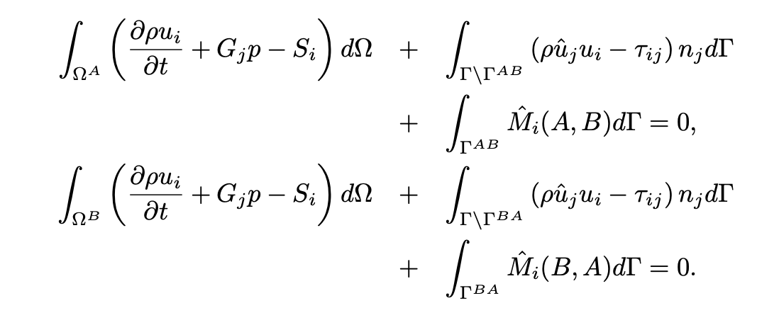
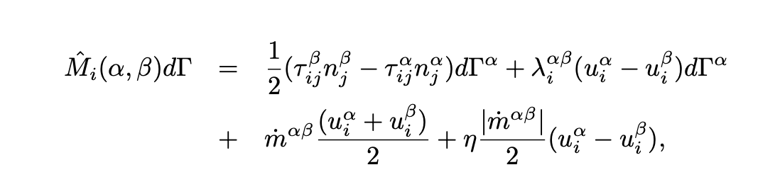
CVFEM and EBVC Fluids-Based (Same Approach)
Momentum

Slide 15
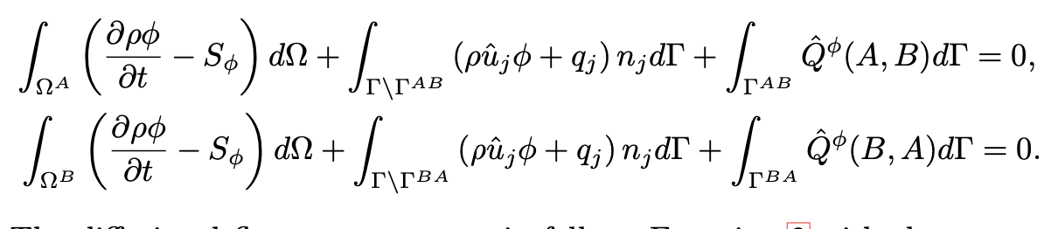
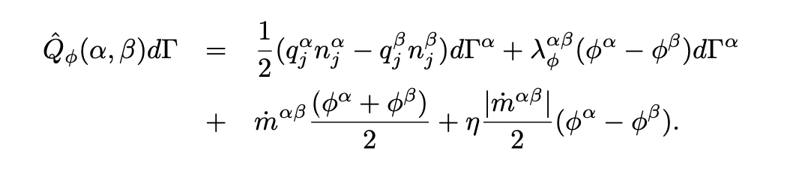
CVFEM and EBVC Fluids-Based (Same Approach)
Scalar

Slide 16
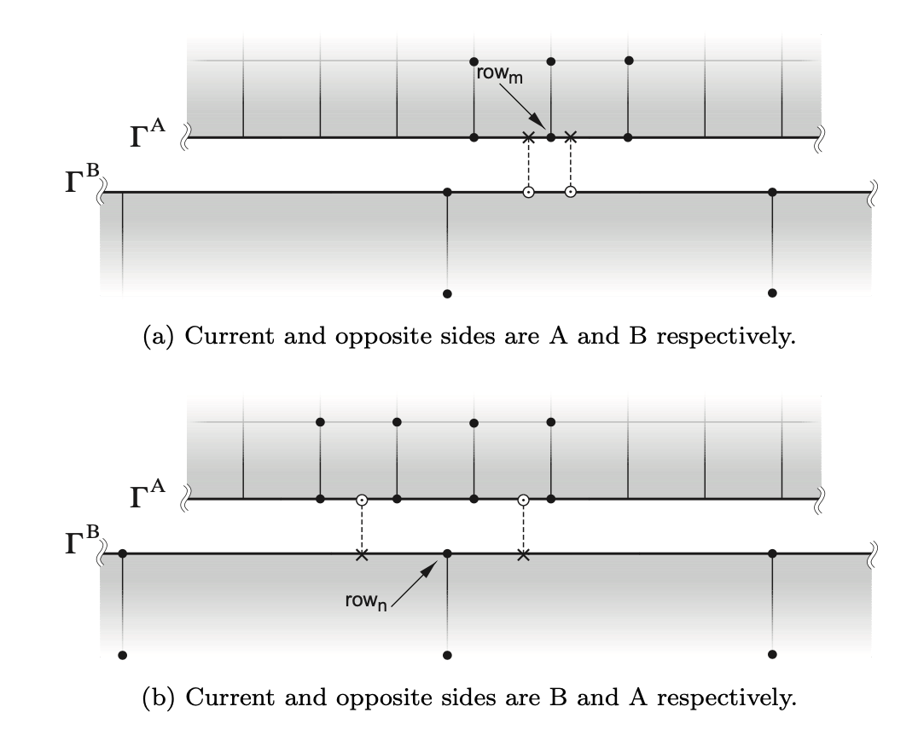
Limit as Interface Matches
Surface-based terms cancel

Slide 17
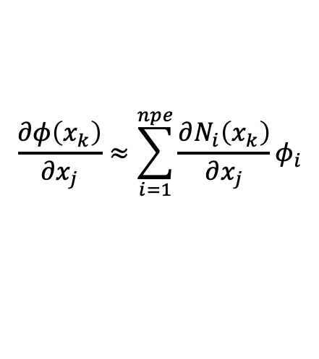
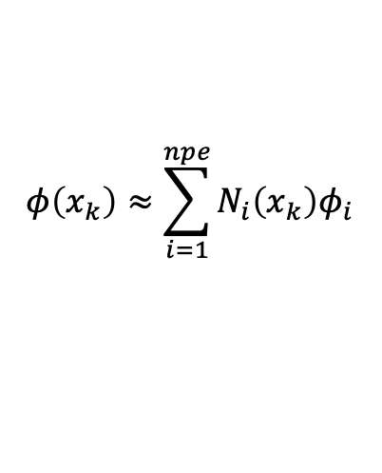
Compatible with EBVC
Non-conformal flux contribution also uses hybrid DG/CVFEM approach
Low cost since generally an edge-based scheme requires the dual mesh infrastructure
$$φ\left(x_{k}\right)≈\sum_{i=1}^{npe}{N_{i}\left(x_{k}\right)φ_{i}}$$
$$\frac{∂φ\left(x_{k}\right)}{∂x_{j}}≈\sum_{i=1}^{npe}{{\frac{∂N_{i}\left(x_{k}\right)}{∂x_{j}}φ}_{i}}$$

Slide 18
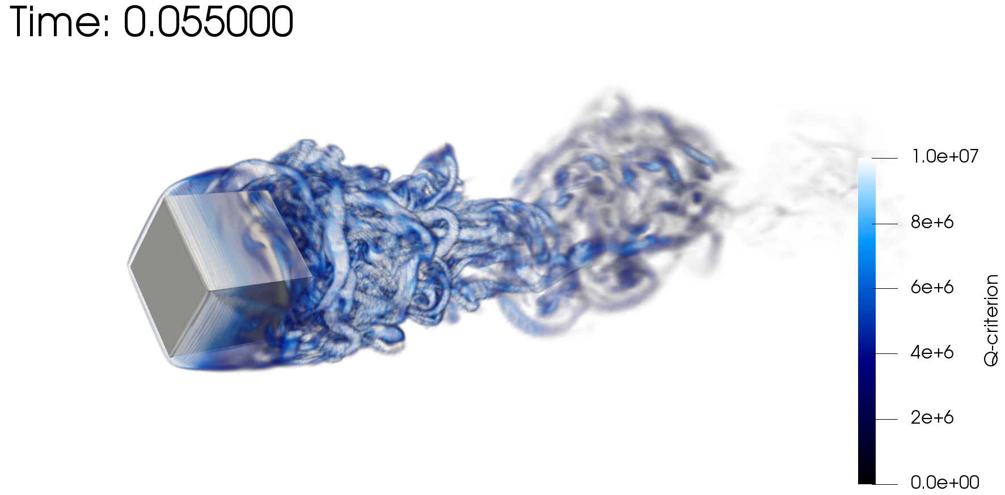
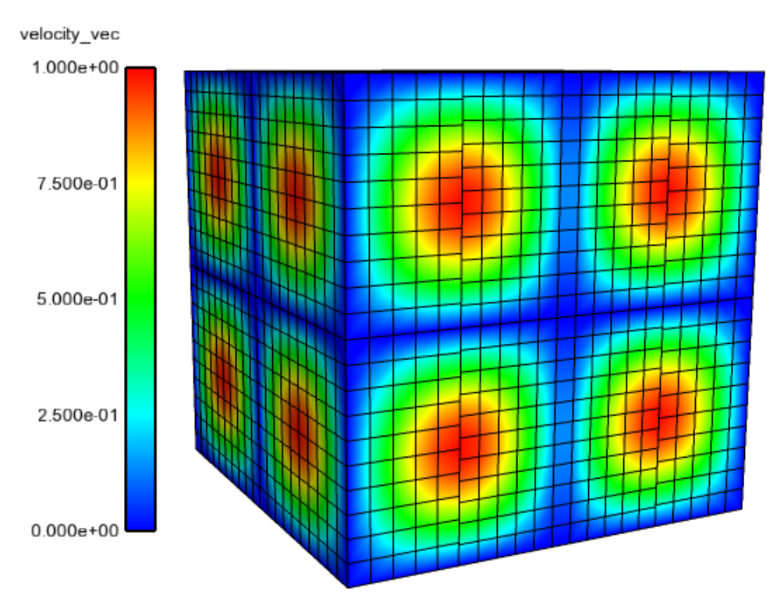
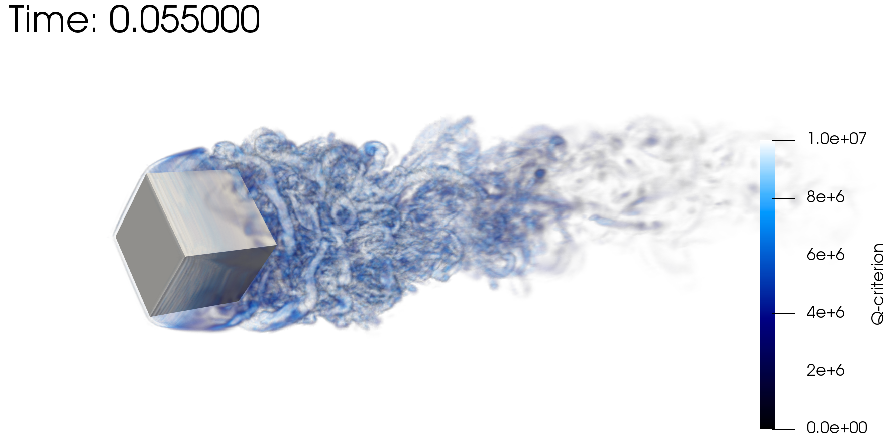
Verification and Validation
2D and 3D Steady, uniform and variable density flows
Flow-past rotating cube
Re~4000, RPM~3200
Same node count,
P=1 (top) P=2 (bot)

Slide 19
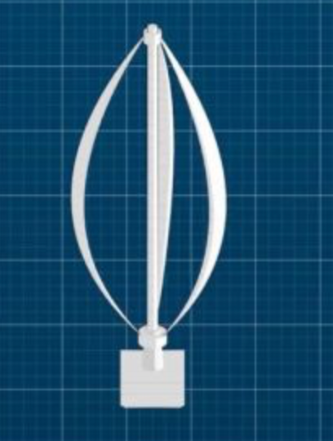
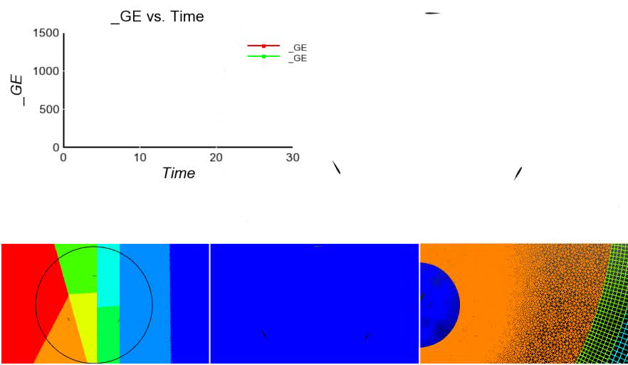
Parallel Decomposition
May be beneficial to load-balance at the interface
Vertical Axis Wind Turbine (VAWT) With Ghosted Elements (_GE) as a function of time

Slide 20
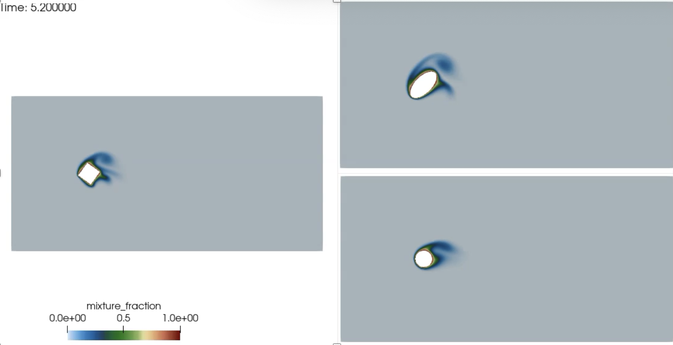
Flow Past Shapes: Nalu/examples/shape
Similar in concept to the midterm; drag and lift, now with a rotating object
Hybrid CVFEM/DG for sliding mesh interface, Domino, JCP, 2018
Two mesh resolutions provided, R0 and R1

Slide 21
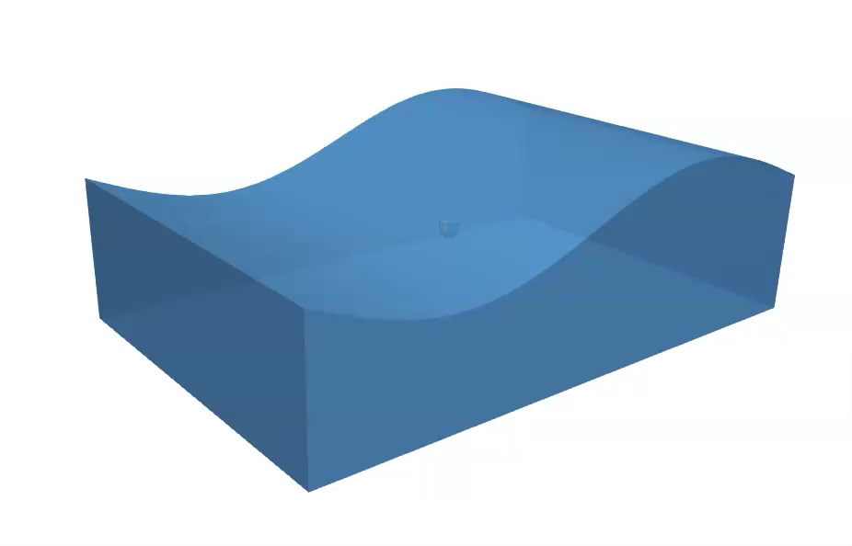
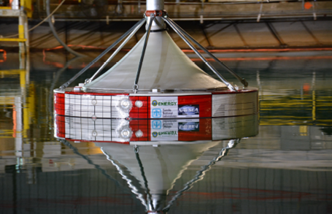
What if Bluff Body Does Not Move Along Pre-defined Directions?
Many applications in which the motion of the body may be coupled to the flow field and, in general, is not known
Wave Energy Converters, Wind Energy with substantial tip deflection, pilot ejection, six-degree-of-freedom maneuvering simulation, etc.
Coe et al, “Advanced WEC dynamics and controls FY16 testing report”, SAND2016-10094 (2016)
Buoy float test

Slide 22
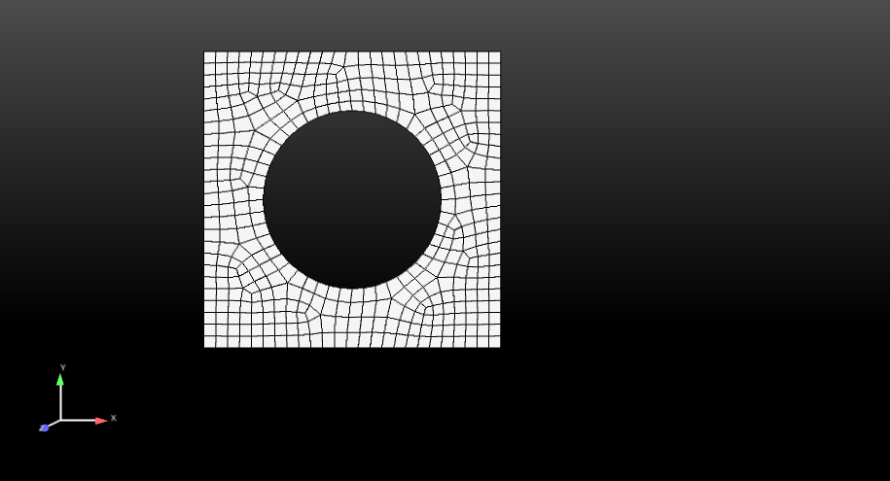
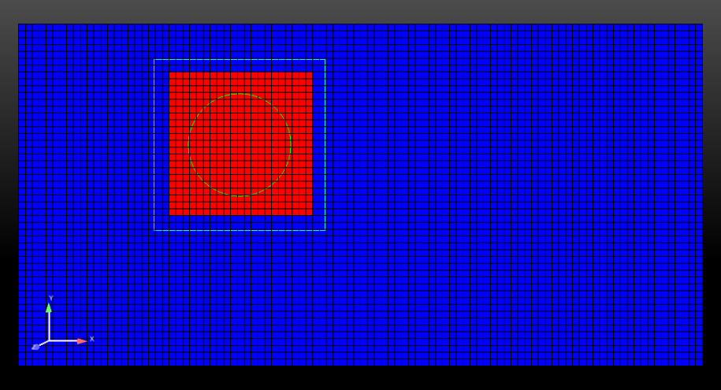
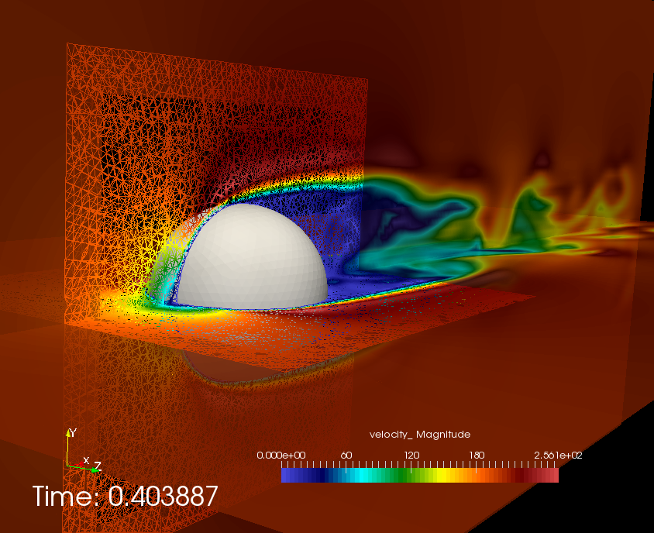
Overlapping or Overset Methods
Chesshire and Henshaw, “Composite overlapping meshes for the solution of partial differential equations. J. Comput. Phys., 90(1):1-64, 1990.
Two Meshes: Background and Overset
Define background and overset mesh
Hole Cut
Definition of exposed nodes that serve as constraint (most common)
[1]
Red Block is “inactive”
BLOCK_2
BLOCK_1
Surface_1 (read in)
New surface of inactive block

Slide 23
Overset: Constraint-based
Apply constraint, φ– Σ_{k} N_{k} φ_{k} = 0 using natural elemental basis or Hermite (for design-order)
Implicit or explicit
Constraint-nodes
Background mesh
Overset mesh
BLOCK_3 (newly declared and
changed part)
BLOCK_1
Surface_1 (read in)
Surface_101 (newly declared and changed part)

